Slide 1

WRGFL AGM Agenda
00 ROLL CALL
01 TO RECEIVE AND CONFIRM THE MINUTES OF THE
PRECEEDING AGM
02 TO CONSIDER ANY BUSINESS ARISING FROM
THOSE MINUTES
03 TO RECEIVE AND ADOPT THE ANNUAL REPORT,
BALANCE SHEET AND STATEMENT OF ACCOUNTS
04 ELECTION OF CLUBS TO FILL VACANCIES (AS
RECOMMNEDED BY THE MANAGEMENT COMMITTEE)
05 CONSTITUTION OF THE COMPETITION FOR THE
ENSUING SEASON
06 ELECTION OF OFFICERS AND MANAGEMENT COMMITTEE
07 APPOINTMENT OF AUDITORS/VERIFIERS
08 ALTERATION OF RULES IF ANY (OF WHICH NOTICE GIVEN)
09 FIX THE DATE FOR THE COMMENCEMENT OF THE SEASON
AND KICK OFF TIMES APPLICABLE TO THE COMPETITIONS
10 ANY OTHR BUSINESS (OF WHICH DUE NOTICE HAS BEEN
GIVEN AND ACCEPTED AS BEING RELEVENT TO THE AGM

Slide 2
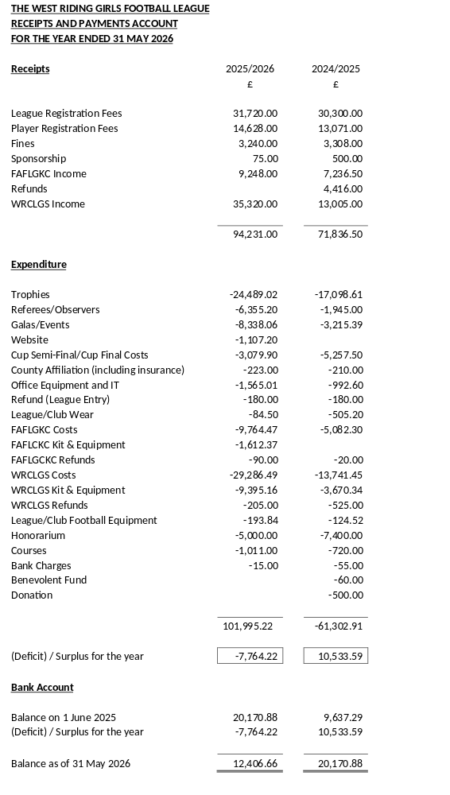
Agenada item o3

Slide 3
Agenda item 04
NEW CLUBS SEEKING MEMBERSHIP
A1FC (FA)
AFC POGMOOR (FA)
ASKERN MINERS JFC (FA)
CHURWELL LIONS JFC (FA)
HALIFAX AMATEURS JFC (FA)
HEBDEN ROYD JFC (PM)
HORBURY TOWN JFC (FA)
KIRKBURTON JFC (PM)
MIDDLETON PARK JFC (PM)
MONK FRYSTON UTD FC (FA)
NETHERTON JFC -HUDDS (FA)
PANNAL SPORTS JFC (FA)
SHELLEY FC (FA)
SKIPTON JUNIORS FC (PM)
SOUTH LEEDS COLLIERIES JFC (FA)
SOWERBY BRIDGE JFC (FA)

Slide 4
Agenda item 05
LEAGUE CONSTITUTION 2026-2027
U07 – 3V3 LEAGUE GAMES ONLY
U08 – 5V5 LEAGUE GAMES – KNOCK-OUT COMPETITIONS (TBA)
U09 – 5V5 LEAGUE GAMES – KNOCK-OUT COMPETITIONS (TBA)
U10 – 7V7 LEAGUE GAMES – CUP, SHIELD, PLATE & TROPHY COMPETITIONS
U11 – 7V7 LEAGUE GAMES – CUP, SHIELD, PLATE AND TROPHY COMPETITIONS
TOGETHER WITH U12 COUNTY CUP
U12 – 9V9 LEAGUE GAMES – CUP, SHIELD, PLATE AND TROPHY COMPETITIONS
TOGETHER WITH DISTRICT FA COMPETITION
U13 – 9V9 LEAGUE GAMES – CUP, SHIELD, PLATE AND TROPHY COMPETITIONS
TOGETHER WITH COUNTY CUP
U14 – 11V11 LEAGUE GAMES – CUP, SHIELD, PLATE AND TROPHY COMPETITIONS
TOGETHER WITH DISTRICT FA COMPETITIONS
U15 – 11V11 LEAGUE GAMES – CUP, SHIELD, PLATE AND TROPHY COMPETITIONS
TOGETHER WITH U15 COUNTY CUP
U16 – 11V11 LEAGUE GAMES – CUP, SHIELD, POSSIBLE PLATE AND TROPHY
COMPETITIONS TOGETHER WITH COUNTY CUP
U18 – 11V11 LEAGUE GAMES – CUP, SHIELD, POSSIBLE PLATE AND TROPHY
COMPETITIONS TOGETHER WITH COUNTY CUP OR
DISTRICT FA COMPETITIONS (U17 ONLY)

Slide 5

Agenda item 06
MANAGEMENT COMMITTEE - SEASON 2026-2027
Chairperson: Wayne Lockwood
Vice Chairperson: Alex Maurice
Secretary: Russ Clarke
Assistant Secretary: Tracey Lockwood
LWO: Becky Alderson
Safeguarding Officers: Paigan Gray
Nathan Martin
Heath Fisher
Susan Bailey
Treasurer: Bev Anthony
Discipline: Vacant
Registrations: Russ Clarke
Fixtures: Rob Jennings
Age Group Representatives Carl Booth
Stuart Smith
Steve Huddleston
Vicky Eastwood
Referees: Carl Ridyard
Social Media: Vacant
County Squads: Alex Maurice/Tracey Lockwood
FA Future Lionesses: Russ Clarke/Wayne Lockwood

Slide 6

Agenda item 08
PLEASE USE SHEETS SENT TO YOU WITH YOUR AGM PACK (THESE SHOULD HAVE BEEN PRINTED OFF)

Slide 7
Agenda item 09 (01)
LOCAL AUTHORITY SCHOOL HOLIDAY DATES AND OTHER SIGNIFICANT DATES – SEASON 2026/2027
OCTOBER HT 2026 CHRISTMAS 2026 & FEBRUARY HT 2027 RAMADAN 2027
NEW YEAR 2027
24 October 2026 to 19 December 2026 13 February 2027 to 07 February 2027 to
01 November 2026 to 03 January 2027 21 February 2027 09 March 2027
(exact dates tbc)
EASTER 2027 MAY BH’S 2027 WRGFL CLOSED DATES EID AL-FITR
27 March 2027 03 May 2027 26 December 2026 9/10 March 2027 Approx
to 11 April 2027 31 May 2027 02 January 2027
27 March 2027 EID AL-ADHA
17 May 2027 Approx

Slide 8
Agenda item 09 (02)
LEAGUE SEASON STARTS
SATURDAY 12 SEPTEMBER 2026
CUP & PLATE ROUND PLAYING DATES SHIELD & TROPHY PLAYING DATES
26 SEPTEMBER 2026 28 NOVEMBER 2026
17 OCTOBER 2026 12 DECEMBER 2026
28 NOVEMBER 2026 30 JANUARY 2027
12 DECEMBER 2026 27 FEBRUARY 2027
30 JANUARY 2027 20 MARCH 2027
27 FEBRUARY 2027 17 APRIL 2027
20 MARCH 2027
17 APRIL 2027
CUP-SHIELD-PLATE-TROPHY FINALS
08 MAY 2027

Slide 9

Agenda item 09 (03)
KICK-OFF TIME PROPOSALS
WRGFL MC PROPOSAL
EARLIEST KICK-OFF 09:30 SATURDAY
LATEST KICK-OFF 12:30 SATURDAY
MIDWEEK FIXTURES DEFAULT TO THURSDAY WITH KICK-OFF 18:30
GAMES CAN BE PLAY OUT OF THESE TIMES AND DAYS IF BOTH TEAMS COMPETING AGREE AND THE WRGFL ARE NOTIFIED

